Slide 1

BEST PRACTICE AV DESIGN DOCUMENT
ACOUSTIC RECOMMENDATIONS FOR MEETING ROOMS AND AUDITORIUMS
DISCLAIMER: All rights reserved. This document is based on the expertise gained by All Wave AV Systems Pvt. Ltd. over numerous installations. No part of this document may be used or reproduced (even electronically or mechanically by means such as photocopying) without prior consent of All Wave AV Systems. You may write to
contact@allwaveav.com for obtaining the rights for reuse.

Slide 2
Table of contents
Page no | Sub-Topic
1 A,B | Meaning and importance of acoustics
2 | Types of reflections
3 | Flutter echo
4 | Reverberation Time
5 | Speech Transmission Index and other definitions
6 | Noise Criteria and Sound Transmission Class
7 | What has to be done with late reflections?
8 | Cultivation of early reflections
9 | Diffusion of late reflections
10 | Acoustic treatment for rooms
11 | Absorptive material for room walls
12 | Examples of absorbers and diffusers
13 | Isolation quality of walls
14 | Conclusion

Slide 3
1 A. Meaning and importance of acoustics
What does Acoustics mean?: Acoustics is a science that deals with the production, control, transmission, reception, and effects of sound. Acoustics determine the ability of an enclosure (such as an auditorium) to reflect sound waves in such a way as to produce distinct hearing.
Importance of having optimum acoustics: It is preferred to work in environments that sound good to foster collaboration and support productivity.
Sound within a room is comprised of direct sound, early reflections, late reflections and reverberation-
Direct sound passes straight from the loudspeaker to the listener’s ear.

Slide 4
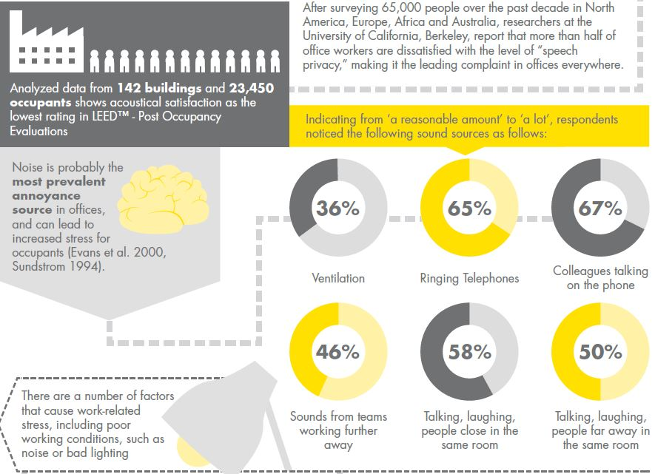
1 B. Meaning and importance of acoustics
.

Slide 5
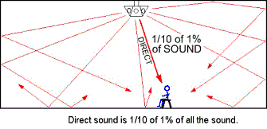
2. Types of reflections
Any reflections arriving at a listener’s ear within 60ms are known as early reflections and are almost indistinguishable from the original sound source. They improve the loudness of the perceived sound.
Late reflections are those that arrive after 60 ms following the reception of the direct signal. They can stretch out up to around 250 ms (1/4 seconds) or so.
Reverberation is the kind of sound that begins to be felt about 1/4 second after the direct signal passes by and lasts for 2 to 5 seconds.They are typically of lower amplitude and very closely spaced in time. They are a general din of noise that takes long time to die out compared to the rapid sequences of speech sounds.

Slide 6
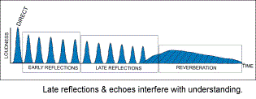
3. Flutter echo
If a room is too reflective then the level of the late reflections and reverberant field can smear or cloud the direct sound, decreasing the productivity of the meetings held within.
Another loud the direct sound, making it harder to distinguish between words and common acoustical problem in meeting rooms that can degrade the intelligibility of speech is flutter echo. Flutter echo occurs when two reflective surfaces within a room are parallel (e.g. glass partitions and windows), causing sound waves to bounce back-and-forth. In contrast to reverb, even if the reflections arrive at the listener in under 60ms, the repetitive
nature of the reflections make them
audible as a flutter.

Slide 7
4. Reverberation Time
Reverberation Time (RT60): Reverberation Time is the time required, in seconds, for the average sound pressure level in a room to decrease 60 decibels after a source stops generating sound.
When expressed in units of cubic and square meters, the reverberation time is given by RT =0.161V/A , where V is the volume of the room and A is the effective ‘total absorption’ area.
The ‘total absorption’ area is calculated as the sum of all surface areas in the room, each multiplied by its respective absorption coefficient.
Air contributes a substantial amount to the absorption of high frequency sound.
Taking account of air absorption, RT = 0.161V/ (A+mV) , where m is a constant which varies with air temperature, humidity, and frequency.
Recommended RT60 is between 0.6 and 1 second.

Slide 8
5. Speech Transmission Index and other definitions
The Speech Transmission Index (STI) is an objective, physical measure of speech transmission quality. The STI is a 0 to 1 index, indicating the degree to which a transmission channel degrades speech intelligibility. This means that perfectly intelligible speech, when transferred through a channel with an associated STI of 1, will remain perfectly intelligible. The closer the STI value approaches zero, the more information is lost.
Videoconferencing (VC) is the conduct of a videoconference by a set of telecommunications technologies which allow two or more locations to communicate by simultaneous two-way video and audio transmissions. It has also been called 'visual collaboration‘.
A teleconference (TC) is the live exchange and mass articulation of speech information among several persons and machines remote from one another but linked by a telecommunications system.
A Local Speech Reinforcement (LSR) system is the combination of microphones, signal processors, amplifiers, and loudspeakers all controlled by an audio mixing board that makes live or pre-recorded sounds louder and may also distribute those sounds to a larger or more distant audience.

Slide 9
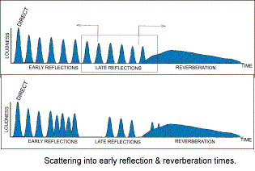
6. Noise Criteria and Sound Transmission Class
Noise Criteria (NC): A NC level is a standard that describes the relative loudness of a space.
Sound Transmission Class (STC): STC rates a partition's or material's ability to block airborne sound.
We should eliminate or at least temper the late reflections. Late reflections can be moved forward in time into the early
reflection time period, by repositioning
the reflecting surface.
They can also be shifted backwards in
time into the reverberation time
period.

Slide 10
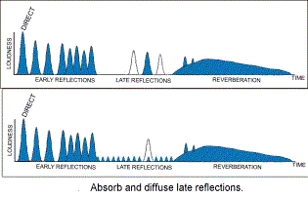
7. What has to be done with late reflections?
Late reflections can be simply eliminated by absorbing them. They can also be splintered into numerous small reflections by diffusing them.
Following this should be a low level rise and fall of reverberation, again in the range of about 15 dB below the direct and early reflected signals. The overall reverberation should fall away and become inaudible within 1 second following the initial direct signal.

Slide 11
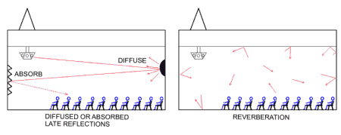
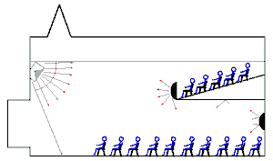
8. Cultivation of early reflections
The early reflections need to be cultivated. The balcony facing is sculpted to provide early reflections back down to the
main floor. The back wall of the balcony
and ceiling is sculpted to provide early
reflections into the balcony seats.

Slide 12
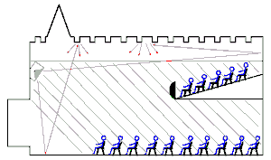
9. Diffusion of late reflections
The late reflections are mainly dealt with by combining two features. It begins with having a heavily coffered ceiling. Any sound that is heading upwards eventually hits the coffered ceiling, only to be splintered into a cascade of tiny and off angled reflections.
Other sounds that are traveling upward
that went over the heads of the balcony
seating continues upwards after the wall
bounce and are also intercepted by the
deeply coffered ceiling. The coffered
ceiling acts to diffuse and randomize
the late reflections in the hall.

Slide 13
10. Acoustic treatment for rooms
Rooms-
When looking at acoustic room treatment we should consider both absorption and diffusion.
Absorption reduces the amount of sound energy that is reflected back into the room by absorbing energy from a sound wave as it passes through. Absorption helps to reduce the reverberant field and minimize the impact of flutter echoes or standing waves.
Absorbers are typically manufactured from high-density foam or fibreglass in various shapes, sizes and colours.
Absorptive materials are necessary for the ceiling. The perimeter of the ceiling is made absorptive and the area above the boardroom table is kept reflective.

Slide 14
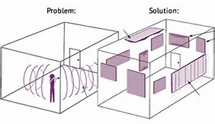
11. Absorptive material for room walls
Parallel reflective surfaces can cause flutter echo or standing waves. So ideally, at least the back wall and one side wall should be treated with acoustically absorptive material.
It’s not necessary to completely treat the wall as long as the critical zone (normally from 3'-7') is treated with a material that has an NRC (Noise Reduction Coefficient) of at least 0.50. An NRC of 0 indicates
perfect reflection; an NRC of 1 indicates
perfect absorption.

Slide 15
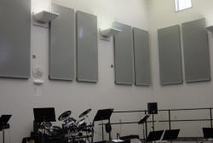
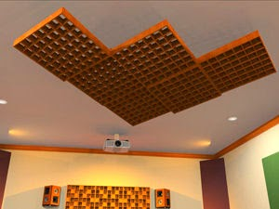
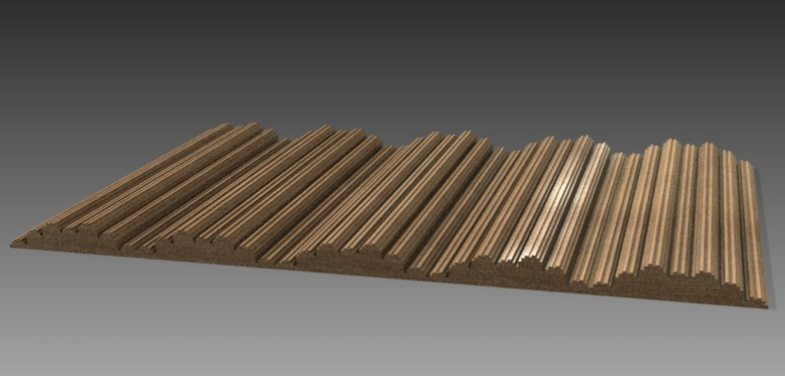
12. Examples of absorbers and diffusers.
Absorber
Coffered ceiling as diffuser
Diffuser

Slide 16
13. Isolation quality of walls
If confidentiality or privacy is an issue, you need to be concerned with the isolation quality of the wall. Even if you specify a high STC rating for the wall, it will not allow for privacy if the wall only extends to the ceiling, or just above the ceiling. To help ensure confidentiality, the wall must extend to, and seal to, the deck.
If your main concern is the transmission of sounds of people talking, this chart gives you an idea of the effect you can expect if you are on the other side of a partition with a given STC rating:
STC Speech-blocking Effect
20-25 Quiet speech is audible
25-30 Ordinary speech is audible and intelligible
30-35 Loud speech is audible and intelligible
35-40 Loud speech is heard but is rarely intelligible
40-50 Loud speech can be heard, faintly
50-60 Loud sounds can barely be heard

Slide 17
14. Conclusion
Acoustics are fundamentally important to learning and working environments. Both are intrinsically linked with communication, and aural (sound) communication is acoustics. Similarly, both are all about concentration, and external noise is a major distracting factor in such environments.
Early reflections should be cultivated. Late reflections should be eliminated by absorption or should be diffused.
To prevent flutter echo or standing waves, the back wall and one side wall should be treated with acoustically absorptive material.
For speech privacy, a wall with high Sound Transmission Class (STC) that extends upto the deck should be chosen.

